Slide 1
Optimizing Health for Teens
Educating yourself on the choices you make with food today
will empower you to thrive for the rest of your life

Slide 2
Agenda
Who we are
Why learning how to eat matters
How to eat to support your goals
Supplements
Q & A

Slide 3
Who we are
Sharan Scali
UVIC Bachelor of Commerce Degree with a minor in Nutrition
Advanced Sports & Exercise Nutritional Advisor Certification from the Health & Sciences Academy
Precision Nutrition Level 1 Certification
CrossFit Level 1 Certification
KiloOpen 58 kg Gold Medalist in Olympic Lifting
Qualified for BC Provincials in 2015 for Olympic Lifting
Owner of Semiahmoo Athletic Club since 2014
Owner of SnS Nutrition since 2014
Notes:
I graduated from UVIC and pursued formal nutritional training later in life when I was unhappy with the body that I was living in and wanted to increase my self confidence but also my energy to get through the day without crashing. Just like most people, I was confused about what the best diet or exercise program was for my goals, and I wasn’t satisfied with the answers I was getting.
Fast forward 10 years later and I went from never having lifted a weight in my life, to competing in CrossFit and Olympic Weightlifting.
I’ve been coaching nutrition for over a decade now. I have coached everyone from pro athletes in the NHL, to CrossFit Games athletes like my husband, to average gym goers. Most of my clients are people like your mom and dad who were never educated on the basic principles of nutrition. They’re confused with all the fad diets out there and blame their slowing metabolism on being unhappy with their body or feeling low energy all the time, when in reality, it’s their diet and lifestyle habits that are leading to their negative body image thoughts and growing list of health issues.

Slide 4
Who we are
Joe Scali
Bachelor of Commerce from Cornell University
CFP Certified Personal Trainer
CrossFit Level 1 Trainer
TRX Certified Trainer
Trigger Point Performance Therapy Certification
Twist Conditioning Bronze Silver Gold Certification
Played hockey for Cornell University
Played Professional Hockey for Laredo Bucks
Qualified for The CrossFit Games in 2015 + 2018
Owner of Semiahmoo Athletic Club since 2014

Slide 5
Why does nutrition matter?
There is no such thing as a one-size-fits-all diet, which is why fad diets or restrictive lists of what you can and cannot eat will not serve you in learning how to achieve and sustain your goals for the rest of your life.
Factors such as genetics, gender, age, lifestyle, and body type all influence how your body will respond to a program. Studies have proved that the same food impacts different people in different ways, which is why learning how to personalize your diet is the true key to success.
There is no "right way" to eat, only the best way for your unique body and goals.
Notes:
The constantly evolving world of nutrition can make it very difficult to learn how to eat for your unique body and goals. With new diet fads, fitness regimens, and supplements proclaiming to be the magic key to success, it's no wonder most of us are left confused on the "best" strategy to reach your goals. The goal of this presentation is to teach you that there is no one-size-fits-all method to success - customization is the key to creating a program that allows you to thrive. Factors such as genetics, gender, age, lifestyle, and body type all influence how your body will respond to a program. Studies have proved that the same food impacts different people in different ways, which is why learning how to personalize your diet is the true key to success.
By educating yourself on the basic principles of nutrition, you can become more in tune with your body to gain a better understanding of the messages it may be sending you. Instead of relying on a restrictive dieting protocols such as lists of foods that you can and cannot eat, you will learn how to pay attention to how you physically and emotionally feel after eating specific foods, with the goal of creating a customized program that allows you to feel energized, happy, strong and healthy!
Learning how to optimize your health today will prevent you from turning to extreme caloric restriction, excessive exercise and expensive supplements. This method will empower you to not only reach your body composition goals, health and fitness goals, but also maintain them long term while being happy with the body that you’re in.
Remember, there is no "right way" to eat, only the best way for your unique body and goals.

Slide 6
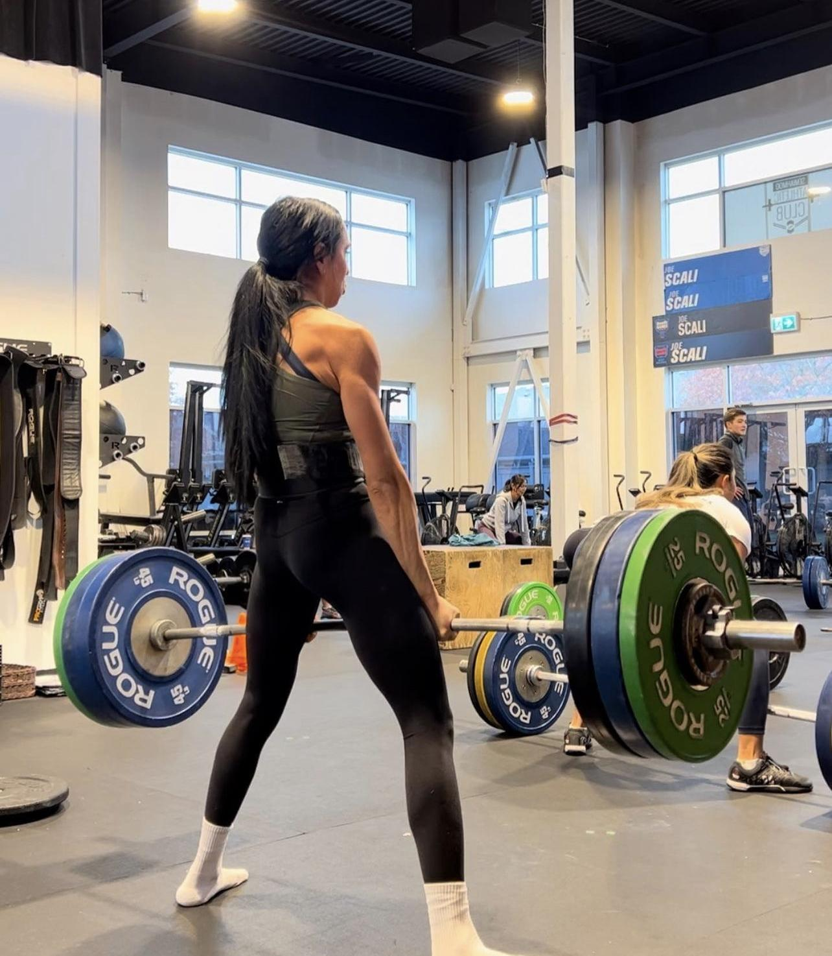
Disordered Eating Habits
2008
-excessive cardio + extreme caloric restriction to lose body fat
2022
-strength training and eating enough food to fuel muscle growth
Notes:
1 in 7 men and 1 in 5 women experiences an eating disorder by age 40, and in 95% of those cases, the disorder begins by age 25.
When most people think of eating disorders, they think of someone who is overly thin. However, you can have an eating disorder and have a normal weight, or even be overweight. The most important thing that many people don’t realize about eating disorders is that they are a serious mental health issue and can be very dangerous. They can affect and damage many parts of the body — and can even be lethal.
Many people, myself included, will engage in disordered eating habits without even realizing it because we’re surrounded by diet culture messaging from social media, TV, magazines, all pushing the latest fad diets and supplements to look a certain way.
The first picture is me out of high school. I never worked out a day in my life, I could barely lift an empty barbell and like most young adults who start exercising, I did it because I wanted to change the way I looked to boost my self confidence. Every cosmo magazine told me to do excessive amounts of cardio and restrict my caloric intake to get “lean.” So I started running and counting all my calories and maybe I lost some weight, but it was unsustainable because I was miserable throughout the process, and this led to a decrease in optimal hormone production which would have a huge impact on everything from my mental health to my physical health.
Fast forward 15 years and I learned, the hard way, that this way of eating and exercising would NOT help me achieve my goals WHILE enjoying my life. After I educated myself on how to properly achieve my goals, I shifted the focus from using diet and exercise as a means to a temporary body composition goal into something that I could sustain for the rest of my life because it truly helps me FEEL great, function as a competitive athlete, and as a byproduct of shifting that focus from punishing my body with diet and exercise to using diet and exercise as tools to optimize my health, I’ve been able to achieve my body composition goals. Today my focus is on hitting strength PRs in the gym, feeling energized throughout my busy days as a full time working mom, and feeling confident and happy in my body and my relationship with food and exercise, without fearing food and weight gain. This is because I’ve invested the time and effort into educating myself on how to eat, move and live to achieve and sustain my goals for the long term.
There are many ways to increase our health through nutrition and fitness - everything from reducing inflammation to improving gut health WILL result in living a happier quality of life because of the confidence you have to navigate your nutritional journey during the different phases of your life from being a high level athlete to being a mother.

Slide 7
Food Freedom
There’s no problem in having food preferences, but when they morph into rigid rules, and trigger you to feel bad about yourself, it’s time to question those food rules before they take a negative toll on your mental and physical health.
There is no morality or guilt in what you eat. ⁣The only foods you should avoid are the ones that you are allergic to.
Learning how to fuel adequately for your body’s energy requirements NOW will empower you to experience food freedom for the rest of your life. Food freedom is embracing the freedom to eat foods that make you feel good, that are enjoyable and satisfying, and without unnecessary restriction. Food freedom means eating in a way that enhances your life, and that is helpful to your mind, and body, and emotions, and spirit, and culture.
Notes:
Our entire culture – from media to doctors to friends to parents – normalize and reinforce judgmental diet culture thinking, which instils fear of eating specific foods or eating to the point where you’re actually satisfied.
And as we grow older, our lives are constructed and designed to be sedentary. So when we combine a lack of knowledge around eating for our unique body and goals, and lower activity levels as we age, we end up gaining body fat and blame our “slowing metabolism”. To add to that, the diet industry is a multi billion dollar industry preying on those with limited knowledge of what is actually safe and effective to achieve your goals. Supplements and diet programs are not regulated meaning that these things could be, and are, terrible for your health. This is why it’s so valuable to LEARN how to eat to support your health right now, rather than being confused and jumping on fad diets and weight loss programs that are detrimental to your health later in life.
Rather than fearing foods, I want to teach you about Food freedom, which means embracing the freedom to eat foods that make you feel good, that are enjoyable and satisfying, and without unnecessary restriction. Food freedom means eating in a way that enhances your life, and that is helpful to your mind, and body, and emotions, and spirit, and culture.
CUE FOR JOE: talk about fad diets

Slide 8
Food Freedom
REPEAT
DIET
You gain all the weight back, which causes you to become unhappy with your body image again, and the cycle starts over again
You begin with a desire to lose weight
FAMINE
RESPONSE
FEAST RESPONSE
You restrict food to lose weight and as a result of extreme caloric restriction, you lose both lean muscle and fat mass. This process results in a decline in hormones which means lowered metabolic rate and increased fat storage
You experience low energy, poor mood, sleep disturbances, an inability to gain lean muscle mass. Your cravings to eat food you actually enjoy skyrocket, and as a result you indulge in the food you want, which leads to negative body image thoughts and rebound weight gain
FALL OFF
Notes:
Almost 70% of adults are deemed overweight because they’ve never learned how to eat in a manner that supports their health. So they end up getting on these aggressive diets that push their body into a famine response.
Punishing your body with diet and exercise may work for a short period of time, but inevitably your health and hormones start to slide. You have energy crashes throughout the day, you have terrible mood swings, and your cravings to eat food you ACTUALLY enjoy are uncontrollable, so you “fall off” your diet program and eat everything that you’ve been restricting.
You gain all the weight back that you lost, so the negative body image thoughts kick in and so you find another fad diet to repeat the cycle all over again.

Slide 9
Are you eating enough food?
Consistently taking in less energy (calories) than you are putting out (daily activity) is a stressor on the body. Overtime, this leads to a down regulation of optimal hormone levels and metabolic adaptation. Signs you may not be eating enough food include:
-Chronically feeling cold
-Chronically feeling hungry
-Never feeling hungry
-Disrupted sleep patterns
-Inability to gain muscle
-Inability to lose body fat
-Low energy/blood sugar crashes
-Hair loss
-Poor mood/mood swings
Notes:
JOE: So what happens to your body as a result of repeating this cycle over and over again?
Your body is smart and employs a strategy called metabolic adaptation in order to keep you alive. Metabolic Adaptation is the process by which the body alters how efficient it is at turning the food you eat into energy. Your body employs this strategy to keep you alive during periods of elevated stress because it doesn’t know whether you are Joe whose trying to lose a few pounds before his next vacation or whether you are actually starving in a 3rd world country with limited access to food.
Our bodies are equipped with this survival mechanism because when we consider our ancestors were hunting and food and it was plentiful, it meant starvation was not likely and, therefore stress levels were not high - so there was no need for the body to store calories as fat for later use. This means that all the calories you did feed your body were used to fuel your body’s requirements. But, in times of famine, it was essential that one’s metabolism was extremely efficient, so it switched to only using the minimum number of calories to maintain biological functions because the rest of the calories had to be stored as fat for later use to prevent starvation.
So your body responds to diet-induced metabolic adaptation by decreasing the amount of calories that are burned through regular movement, exercise, breathing, etc, which means it becomes harder and harder to lose the weight which each new diet attempt. So regardless of whether you are intentionally or unintentionally restricting calories, you might start to notice a few of the listed signs of not eating enough food such as the ones listed here..

Slide 10
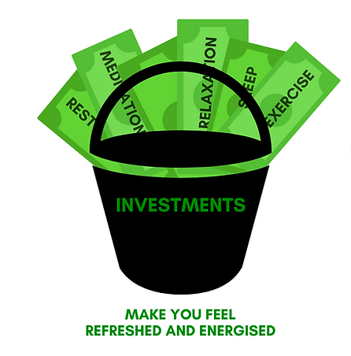
Think of your health like a bank account
Inputs like eating enough nutrient dense food to fuel your body, sleeping adequate hours to allow your body to recover from the strain of the day, getting daily movement, managing stress all contribute to growing your bank account.
Consistently under eating or leaning on highly processed foods, not sleeping enough, over exercising or not engaging in daily movement altogether, and experiencing highly elevated stress levels all drain your bank account.
Learning how to eat to support a thriving bank account will set you up for optimal health for the rest of your life with improved energy, focus, mood, confidence, body composition and the ability to achieve your fitness goals if you are an athlete.
Notes:
Think of your health like a bank account.
Inputs like eating enough nutrient dense food to fuel your body, sleeping adequate hours to allow your body to recover from the strain of the day, getting daily movement, managing stress all contribute to growing your bank account.
Consistently undereating or leaning on highly processed foods, not sleeping enough, over exercising or not engaging in daily movement altogether, and experiencing highly elevated stress levels all drain your bank account.
Learning how to eat to support a thriving bank account will set you up for optimal health for the rest of your life with improved energy, focus, mood, confidence, body composition and the ability to achieve your fitness goals if you are an athlete.

Slide 11
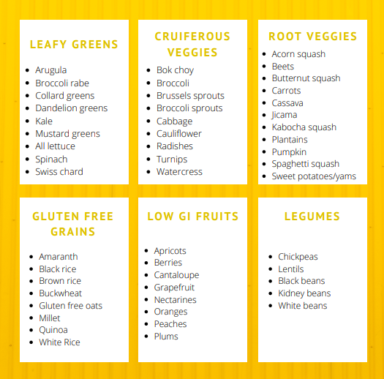
Carbohydrates
Carbohydrates are your body's preferred source of fuel for brain and muscle function. They also support optimal thyroid production by giving your brain and adrenal glands the signal that your body has consumed adequate calories to support your activity output. This ensures that you are not unnecessarily elevating your stress hormone, cortisol, through under-eating and over-exerting. They are also a great source of dietary fibre and resistant starches, which are vital for a healthy gut microbiome.
Notes:
Carbohydrates are your body's preferred fuel source for your brain and muscle function. Your body takes the glucose in carbs and converts it into glycogen that is stored in your liver and muscles to energize you. There are 6 different types that you should focus on.
Leafy greens - these are the foods that give you all the micronutrients you need - so if you’re consuming these 3x a day, you likely don’t need to supplement with vitamins and minerals.
Cruciferous veggies - these veggies detox excess hormones from the body which help create optimal hormone levels
Root veggies - these veggies contain naturally occurring starches, the raw energy to fuel your brain and muscles with glucose. They also help to produce serotonin, the neurotransmitter that promotes feelings of happiness. They also taste sweet and are chock full of fibre, vitamins and minerals which provide a great substitute for sugar rich foods. Aim to consume these in your pre/post workout meal to fuel and recover and/or before bed to promote deep sleep.
Grains - you don’t HAVE to choose gluten free if you’re not allergic to gluten. Most manufactured gluten free products are actually worse for you because they contain filler ingredients to make them taste better. But if you notice that eating gluten causes symptoms like brain fog or bloating, stick to this list of gluten free grains.
Low GI fruits - fruit contains an abundance of vitamins and minerals to promote optimal health, choosing low fructose options help to balance your blood sugar.
Legumes - these foods are full of fibre, vitamins and minerals and if you don’t consume animal meats, these also contain protein.

Slide 12
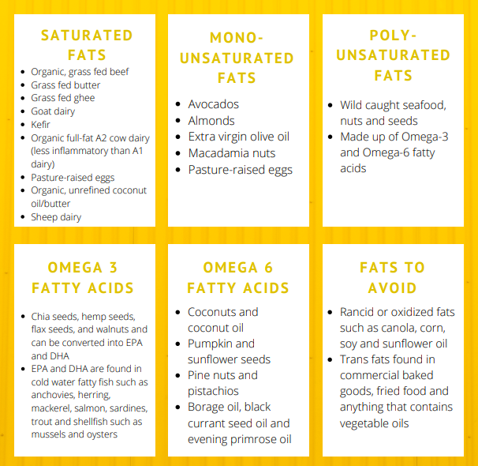
Healthy Fats
Dietary fat is crucial for various functions within the body. Our brain is made up of 60% fat, which means that the food we eat directly feeds our brain and aids in neurological functions. Our livers use healthy fats to make cholesterol, a building block for important hormones such as testosterone, estrogen and progesterone. Healthy fats are also critical for absorption of fat-soluble vitamins such as A, D, E, and K. Consuming adequate levels helps to fuel brain power, prevent brain fog, stabilize emotions, and increase satiety by stimulating the release of leptin - the hormone that tells the brain we are full to prevent overeating.
Notes:
Our brain is made up of 60% fat, which means that the food we eat directly feeds our brain . There are 3 categories of healthy fats:
Saturated Fats - these fats help our body absorb fat-soluble vitamins , they protect our liver from damage by free radicals, strengthen the immune system, support metabolism and provide the material for building hormones.
Monounsaturated Fats - these fats help improve the function of blood vessels and aid in blood sugar control and insulin levels.
Polyunsaturated Fats - these fats are essential fats, which means they are required for normal body functions but your body cannot make them, so you must obtain them from food.
Since most of the food that we consume is high in inflammatory vegetable oils such as canola oil, our ratio of omega 6:3 fats is 20:1, which activates inflammatory pathways in our body. The ideal ratio is 1:1 which is why paying attention to increasing your omega 3 fats is important to correct that inflammation that leads to negative health conditions.
The two categories of fats that we want to avoid are:
Rancid or Oxidized Fats - vegetables oils such as canola, corn, cottonseed, peanut, safflower, soybean and sunflower oils go bad when exposed to excess heat, light, or oxygen.
Trans Fats - unsaturated fats that have been exposed to high heat which makes them inflammatory. These fats are typically found in commercial baked goods and fried foods.

Slide 13
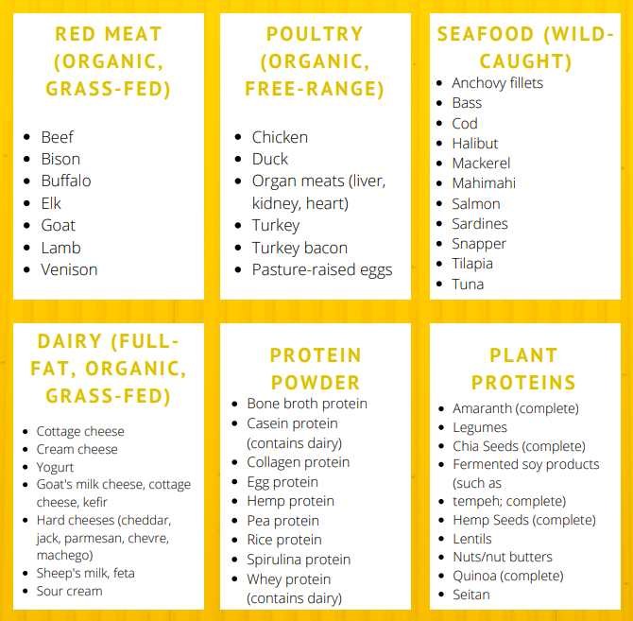
Protein
Protein serves as the raw building materials for the structure of our bodies. It is required to build and maintain lean muscle mass - greater muscle mass promotes mobility, balance, strong bones, insulin sensitivity, and lower inflammation. Protein also acts as the backbone to the brain's chemical messengers which regulate mood. Protein is also essential to carry various fats and other nutrients around the body.
Consuming enough protein also promotes greater satiety, which may prevent the overconsumption of fats and carbohydrates that lead to unwanted fat gain.
Underconsumption of protein may lead to inadequate levels of growth hormone, thyroid function and insulin resistance, which drives the body towards fat storage.
Notes:
Protein is required to build and maintain lean muscle mass, and the more muscle mass you have the better your health will be because muscle improves everything from health markers like insulin sensitivity to building a better body composition. If you have dietary restrictions, it IS important to pay attention to whether you are eating enough complete protein sources.
Animal based protein such as red meat, poultry, fish, eggs, milk, cheese and yogurt are considered complete proteins.
While high-quality dairy products can provide nutrients, if you experience inflammation, acne, digestive issues, congestion, or hormonal pain (eg. period pain), it may be worthwhile to eliminate dairy from your diet. Most dairy comes from factory farms where cows are fed grain, corn, rice and soy products, creating significant inflammation in their bodies. If you do consume dairy, ensure it is full-fat, organic, and free antibiotics and pesticides.
Plant based proteins such as lentils, quinoa and soy are considered complete proteins. You can also combine incomplete protein sources such as brown rice, spinach, beans, cauliflower, carrots, and tahini to make a complete protein combination. It is not necessary to consume a complete protein at every meal, but consuming adequate levels of each amino acid throughout the day may require more planning effort on a vegan/vegetarian diet.

Slide 14
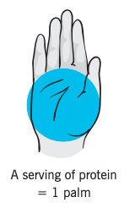
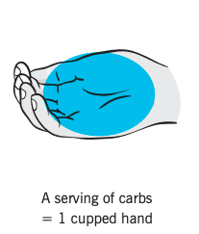
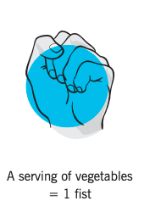
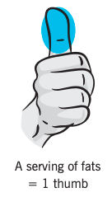
Build Your Plate
Now that you know which nutrient-dense foods support your health, let's determine how much of each macronutrient to include at each meal. Eating well-balanced meals leads to balanced blood sugar levels which promote improved energy, insulin sensitivity and hormonal balance.
Notes:
Now that you know which nutrient-dense foods support your health, let's determine how much of each macronutrient to include at each meal.
Each meal should include a quality source of protein roughly the size and thickness of your palm (4-6oz). If you feel hungry within 30-60 mins of finishing your meal, increase the serving size and evaluate how you feel.
Each meal should include a source of healthy fats. Start with 1-2 golf ball-sized portions of added fat per meal (1-2tbsp of oil/butter, few slices of avocados, handful of nuts, etc) as most protein sources will be accompanied by some amount of fat to contribute to your daily intake.
Your carbohydrates should come from a combination of starchy sources (such as oats, rice, potatoes, bread, pasta) and non-starchy sources such as fruits and vegetables, to obtain ample vitamins, minerals and fibre through your diet.
So in order to determine how much food you need for your unique body and goals, you might start by eating 1-2 palms of protein-dense foods; • 1-2 fists of non-starchy vegetables; • 1-2 cupped handfuls of carb-dense foods; and • 1-2 thumbs of fat-dense foods. This per-meal template is just a starting point. Individual needs and preferences will vary. For instance, men generally need more food than women, younger people more than older people, and athletes more than sedentary people.
Build each meal around protein (eg. Meat, fish, eggs, cottage cheese, greek yogurt) about the size of the palm of your hand (20-30 grams)
Add two fist-sized portions of vegetables (eg. Broccoli, spinach, cucumbers, mushrooms, etc…)
Add two cupped handfuls of starchy carbohydrates (eg. Rice, beans, sweet potato, white potato, bread, fruits, etc) (40-60 grams)
Add a thumb sized portion of fat (nuts, seeds, nut butters, oils, butters) (7-12 grams)
If you feel hungry within 3-=60 mins following that meal, you know you need to increase your portion sizes as a meal should leave you feeling full for 3-4 hours

Slide 15
How does exercise impact your ability to achieve your goals?
Whether you’re an athlete or not, regular movement has a profound impact on the health status of your brain and body. Regular movement has been shown to:
-improve mood, focus, motivation
-reduce depression and anxiety
-boost cognitive performance
-improve energy, sleep and digestion
-build strong muscles and bones
-reduce the risk of developing health conditions such as heart disease, cancer, diabetes and obesity
Notes:
JOE: WHO HERE EXERCISES DAILY? This can be anything from daily walking to strength training to sports. Raise your hand if….
-improve mood, focus, motivation
-reduce depression and anxiety
-boost cognitive performance
-improve energy, sleep and digestion
-build strong muscles and bones
-reduce the risk of developing health conditions such as heart disease, cancer, diabetes and obesity

Slide 16
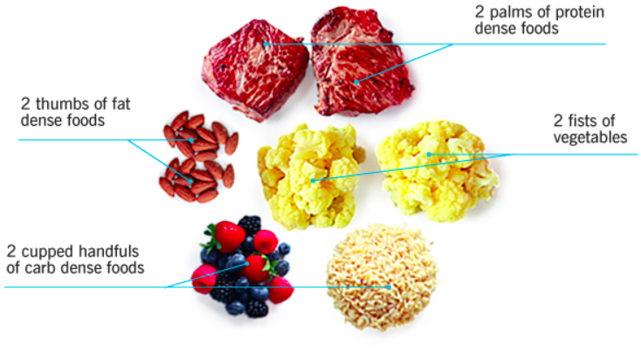
Pre Workout Nutrition
If you have 2-3 hours before exercise, you want a well balanced meal with adequate protein, carbs, fat and fibre
If you have 0-60 minutes before training, you want a smaller meal that is easier to digest such as a protein shake
For example: 1 scoop protein powder, 1 handful spinach, 1 banana, with 1 cup chocolate unsweetened almond milk
Notes:
JOE: KEEP IN MIND THAT IT DOESN”T HAVE TO BE PERFECT
What you eat in the 1-2hrs prior to exercise is to stabilize your blood sugar to provide you with energy to exercise. The energy to workout comes from your stored glycogen (carbs) and if you do not have any carbs to pull from then your body actually starts pulling energy from your hard earned muscle mass, so your body is using the muscle you are trying to build as energy.

Slide 17
Intra Workout Nutrition
Exercise lasting less than 2 hours:
the main focus should be hydration. This is especially true if you’re using good pre- and post-training nutrition. So make sure you bring plenty of water!
What about sports drinks?
They don’t offer much benefit for events less than two hours long. Especially if you ate a good pre-exercise meal
However, if you’re exercising in the heat and sweating a lot, sports drinks may be useful since they have electrolytes that help speed hydration and recovery
If you’re going to be competing or training again in less than eight hours, sports drinks may jumpstart recovery before the next session
If you’re trying to gain maximum muscle, then including a protein and carbohydrate drink during training could provide a small advantage

Slide 18
Intra Workout Nutrition
Exercise lasting more than two hours:
Every hour you’ll want to consume the following to ensure you’re getting enough protein, carbs, electrolytes and sodium
15 grams protein
30-45 grams carbs
This can come in the form of sports drinks, protein powders/bars, energy gels, fruit or other solid foods
If you are exercising intensely for longer than two hours, especially in the heat, do not rely on water alone. This will decrease your performance and your recovery. Under these conditions, when you’re sweating a lot, go with sports drinks or add electrolytes and sodium to your water

Slide 19
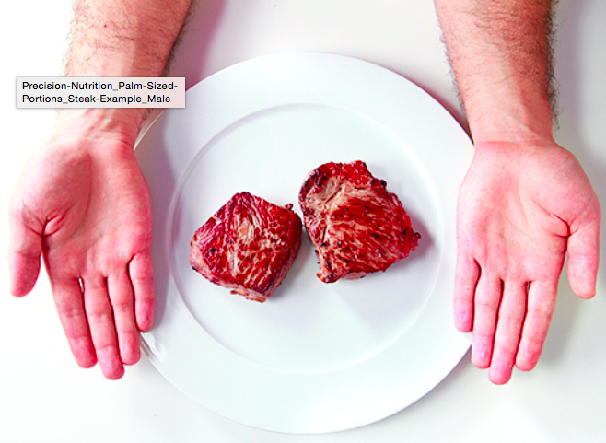
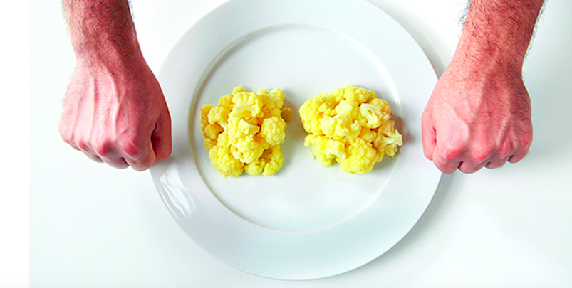
Post Workout Nutrition
A 2:1 ratio of carbs to protein post workout will help you recover, rehydrate, refuel, build muscle and improve future performance
Most athletes can benefit from 0.5g per lb of body weight for post workout carb intake from whole foods such as grains (rice, oats), starchy vegetables (potatoes, yams) and fruit (apples, bananas)
Eating protein after exercise prevents protein breakdown and stimulates synthesis, leading to increased or maintained muscle tissue.
For most young athletes this will be around 25-35g of protein and 50-70g of carbohydrates

Slide 20
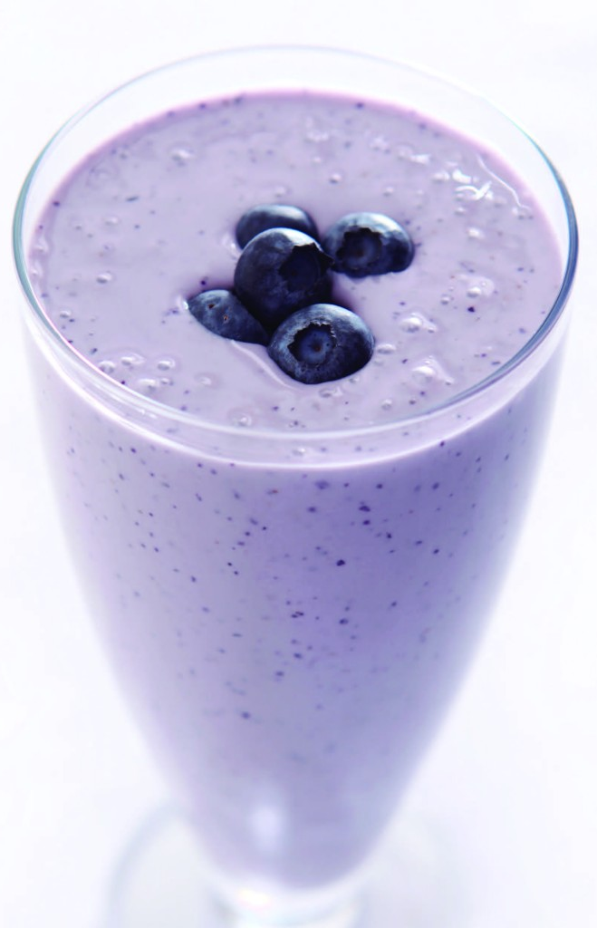
Post Workout Nutrition
Does it matter if you drink a protein shake or eat real meat?
While there are greater health and satiety benefits to eating real food, it’s more important to ensure you are getting enough food, so choose what is most convenient for you.. For example, a shake with 25g of protein and 50g of carbs may include:
1 scoop of protein powder
1 banana
1 cup of frozen blueberries
1 handful of spinach
1/2 cup of uncooked rolled oats
1 cup of dairy or non dairy milk

Slide 21
Hydration
How much water you should drink with exercise can vary depending on many variables such as the length of the activity, heat and humidity, intensity of the practice or game
In general, you should drink 2-4 liters of water (8-16 glasses per day)
Before Exercise: 2 glasses within the 2hr period prior to exercise
During Exercise: 0.5-1 glass every 15-20 minutes during exercise
Post Exercise: Replace 3 glasses for every 1 lb of body weight lost during exercise
Notes:
Water is a nutrient, compromising 55-70% of our body’s composition
Because the body cannot store water, we must constantly provide and supply in with water to maintain our body’s many functioning systems
Drinking water only when you’re thirsty means you are already under hydrated and heading towards dehydration
Dehydration is a major cause of fatigue during exercise
In general, you should drink 2-4L per day and add in a glass for every extra hour you’ve spent sweating

Slide 22
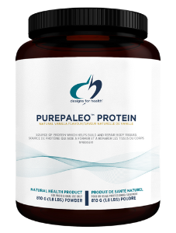
Supplements
Free of common food allergens, making it an excellent choice for people who are sensitive to dairy, soy, rice or other types of protein
Contains complete proteins as well as a significant amount of collagen-specific amino acids, making it helpful in supporting connective tissue
Over 97% pure protein from beef (101.5 protein nitrogen score)
Hydrolyzes the beef protein, making it more bioavailable for improved digestion
Free of hormones
No artificial sweeteners; sweetened with the natural herb stevia
Made with non-GMO ingredients
Notes:
As a Sports Nutritionist, I strongly believe that we can meet the majority our dietary needs by fuelling our body through a diet rich in whole, minimally processed foods.
That being said, science has brought us an abundance of advancements in the form of supplements that can significantly increase performance when paired with a good diet and training plan.
Quality matters. Only use brands that are Informed Choice Certified since the supplement industry is unregulated, meaning you don’t actually know how much protein you are getting per serving or if there are any other filler ingredients in the supplements.

Slide 23
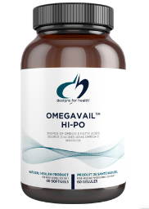
Supplements
Fish Oil is rich in Omega-3 fatty acids (EPA & DHA) which are body cannot produce.
Adding Omega-3s to your diet helps in the development of the brain, eyes and nerves in young athlete and reduces inflammation from intense workouts
If you are not eating oily fish such as salmon, sardines and mackerel 3x a week, you should be supplementing with at least 750mg of both EPA and DHA
Notes:
OmegAvail™ Hi-Po has high bioavailability due to 90+% triglyceride content. The omega-3 fatty acids in this formula are derived from fish oils in their natural triglyceride (TG) form – the same way they naturally occur in fish. Most mass-marketed fish oil supplements come in the synthetic ethyl ester (EE) form which is not as easily digested, and assimilated by the body, and is more prone to oxidation and production of free radicals.

Slide 24
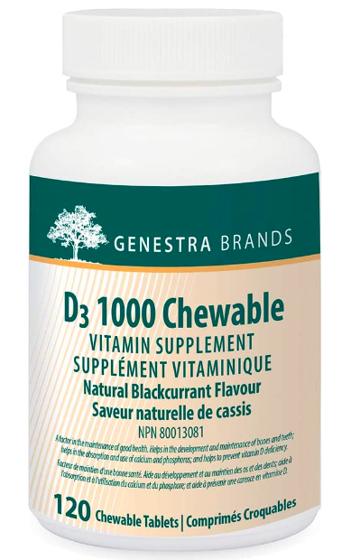
Supplements
Vitamin D—which actually isn’t even a vitamin, it’s a hormone synthesized in the skin from sun exposure, and activated in the liver and kidneys. Even if you live in a sunny climate, if you spend the majority of your day inside, most of the population is deficient in vitamin D.
Vitamin D is a crucial nutrient because it helps regulate your immune system, aids in calcium absorption, and may play a role in mood regulation.
Vitamin D insufficiency affects half the population, is almost never diagnosed, and has been linked to many cancers, high blood pressure, heart disease, diabetes, depression, fibromyalgia, chronic muscle pain, bone loss, and autoimmune diseases like multiple sclerosis.
Most people can benefit from 2000 IU of Vitamin D supplementation.
Notes:
One study showed 80% of COVID patients were deficient in vitamin D, and this was also linked to higher inflammatory blood markers which we know lead to an increased risk for chronic disease. There are other clinical examples that show low vitamin D status in those with COVID-19 leads to an increased severity of symptoms and a higher risk of death. We also already know that vitamin D supplementation can reduce the risk of acute respiratory tract infections and that it plays an important role in immune function, so it makes sense that we should be paying attention to it during cold and flu season, not only because it’s essential for the immune system but also because we have even less of it in the colder months as less time is spent outdoors in the sun.

Slide 25
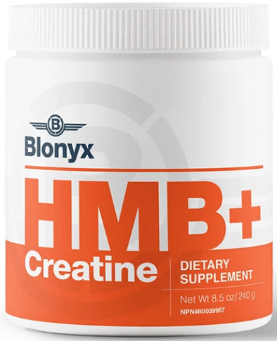
Supplements
Creatine is produced naturally by the body in the kidneys, liver, and pancreas at a rate of about 1-2 grams/day. Creatine can also be obtained from food (particularly red meat) and supplementation.
The energy needs of brief, rapid and powerful movements lasting less than 10 seconds, such as a short sprint, are met by the phosphagen system. This system quickly replenishes ATP stores, which provide energy to the working cells. Muscles have an existing amount of ATP hanging around ready for action, but only a little bit — enough for a few seconds.
Supplementing with creatine means more potential ATP, which translates into improved performance on short-duration, high-intensity tasks. So let’s give hockey as an example - if you want more sustained energy for those short burst of intense shifts on the ice, then supplementing with creatine may be useful for you.
Notes:
Creatine is the most researched supplement on the market

Slide 26
For more questions regarding this presentation or customized nutrition plans please contact Sharan at hello@snatchesandsamosas.com or visit the website to learn more at www.snatchesandsamosas.com

